Slide 1



Correlation of unemployment and crime data for
MERCOSUR nations (2000-2020)
presented by
Name: Raj Sinha
Subject: MADE
IDM id: we90xamu
Matriculation Number: 23196502

Slide 2



Introduction & Motivation
Objective: Explore unemployment-crime correlations in MERCOSUR countries (Argentina, Brazil, Paraguay, Uruguay, Colombia, Guyana) for informed policy-making.
2. Global Focus: Study MERCOSUR for diverse economic, cultural, and governance insights beyond regions.
3. Statistical Analysis: Use data analysis to find patterns, guiding evidence-based policymaking for targeted interventions.
4. Temporal Perspective:Spanning 2000-2020, observe historical trends amidst evolving socio-economic conditions.

Slide 3


Datasets
Unemployment Dataset
Source: International Labour Organisation
Link to Unemployment data
Crime Dataset
Source: UN Office on Drugs and Crime's International
Homicide Statistics database
Link to crime data

Slide 4
Questions
01.
02.
03.
Correlation Inquiry: What is the statistical correlation between unemployment rates and crime rates in the selected global entities over the past two decades?
Comparative Analysis: How do patterns and trends in the relationship between unemployment and crime differ among MERCOSUR countries, considering their diverse economic structures and cultural contexts?
Policy Implications: What evidence-based policy recommendations can be drawn from the analysis to address the interconnected dynamics of unemployment and crime, taking into account the evolving socio-economic conditions influenced by technological advancements and globalization?

Slide 5

Methodology used in the analysis
About Dataset :
Unemployment Data:
Having country names with unemployment rate from 1960 to 2021
Data type : zipped CSV
Crime Data:
Having country names with crime rates from 1960 to 2022
Data type : zipped CSV
2. Making ETL Pipeline :
install dependencies
extraction.py : Responsible for extracting data from the original sources.
transform.py : Responsible for removing null and empty values and transformed into a consistent format.

Slide 6

Methodology used in the analysis
load.py: This code takes charge of storing the processed data in a CSV file.
pipeline.py: This module brings together the extract, transform, and load components into a cohesive automated pipeline
3. Data visualisation & Analysis:
Import libraries
Visualise graphs made and analyse results
4. Problems encountered :
Multiple null values and empty rows in crime dataset.
Shape of both datasets were different
Transformed into 1 shape
Same countries needed to be taken into account by performing set intersection

Slide 7
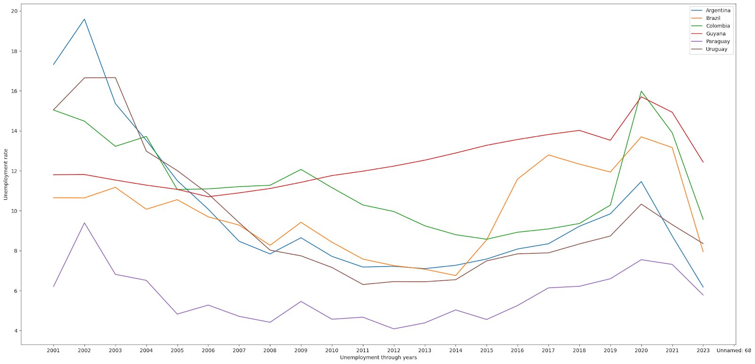
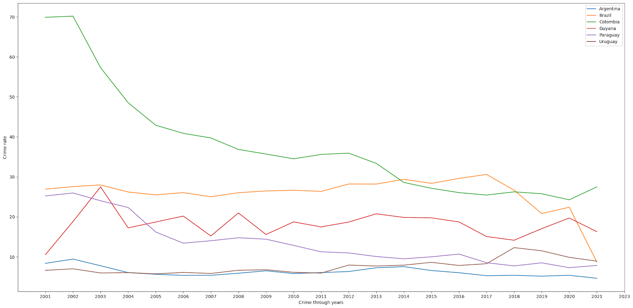
Exploration of datasets
Fig. 1. a) Line plot of unemployment of different countries over years Fig. 1. b) Line plot of crime of different countries over years
Paraguay shows the lowest and most stable unemployment and crime rates, reflecting economic steadiness.
Argentina and Colombia improve significantly, while Guyana and Brazil experience volatility.
Uruguay shows resilience, and global crises impact unemployment across most nations.

Slide 8
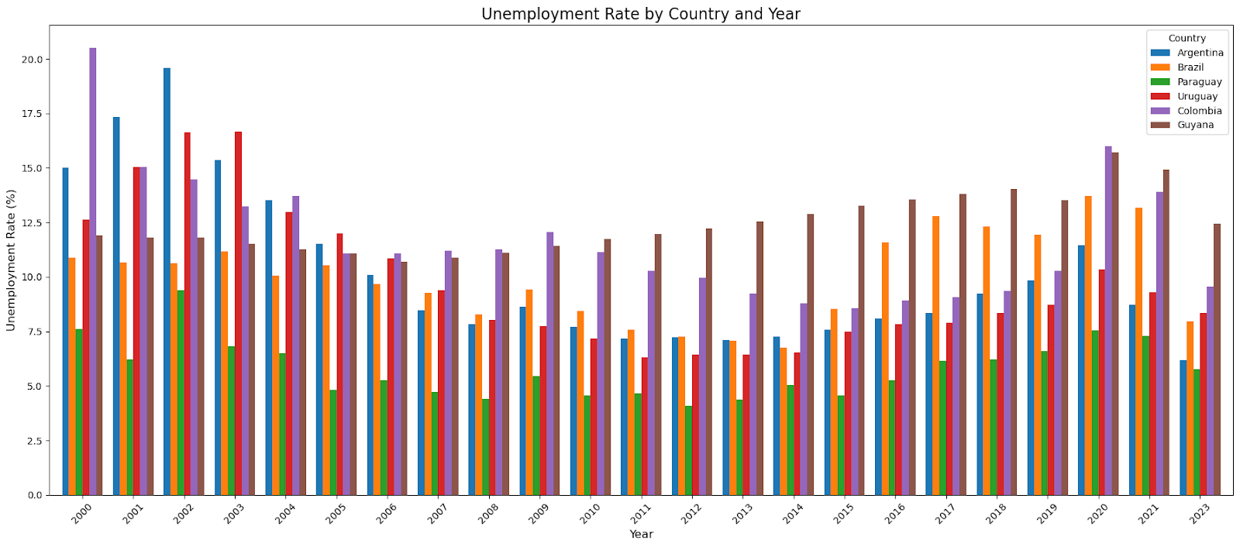
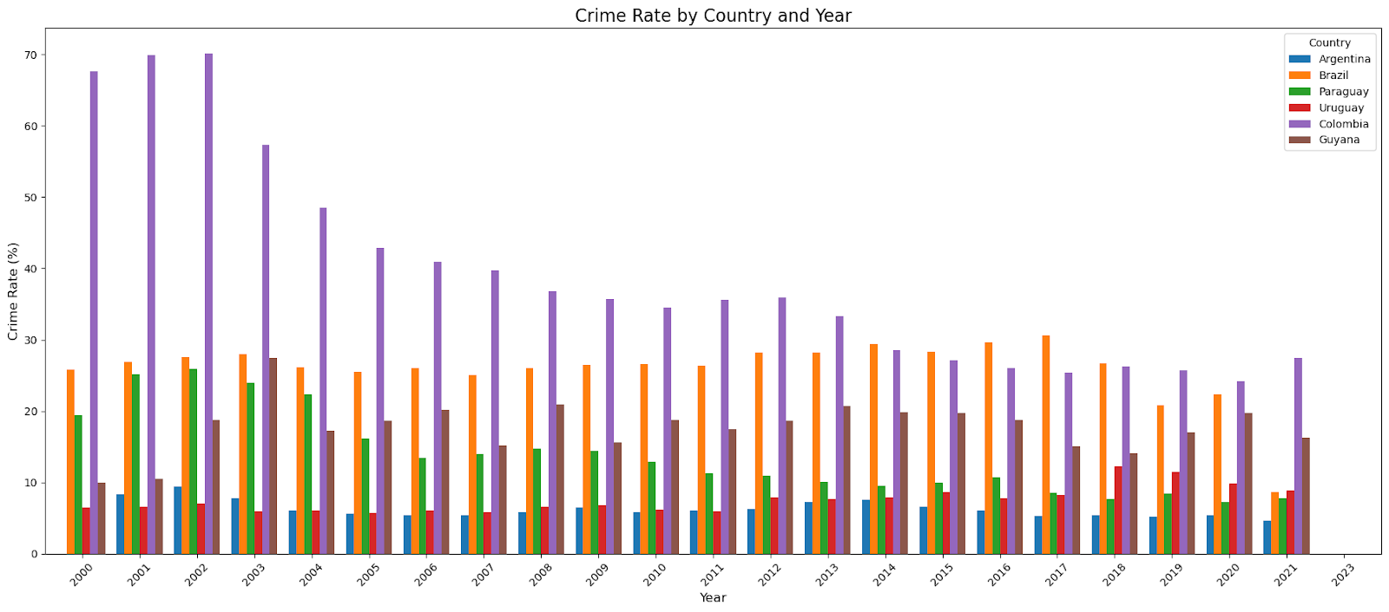
Exploration of datasets
Fig. 2. a) Bar plot of unemployment rate of different countries Fig.2. b) Bar plot of the crime rate of different countries
Paraguay: Lowest and most stable unemployment and crime rates, reflecting steady economic conditions.
Argentina & Colombia: Significant unemployment improvements; Colombia also shows marked crime reduction.
Guyana & Brazil: Volatile unemployment rates and inconsistent crime trends.
Uruguay: Moderate unemployment and crime rates with gradual improvements.
Global Events: Economic crises like 2008 and 2020 significantly impacted unemployment across countries.

Slide 9
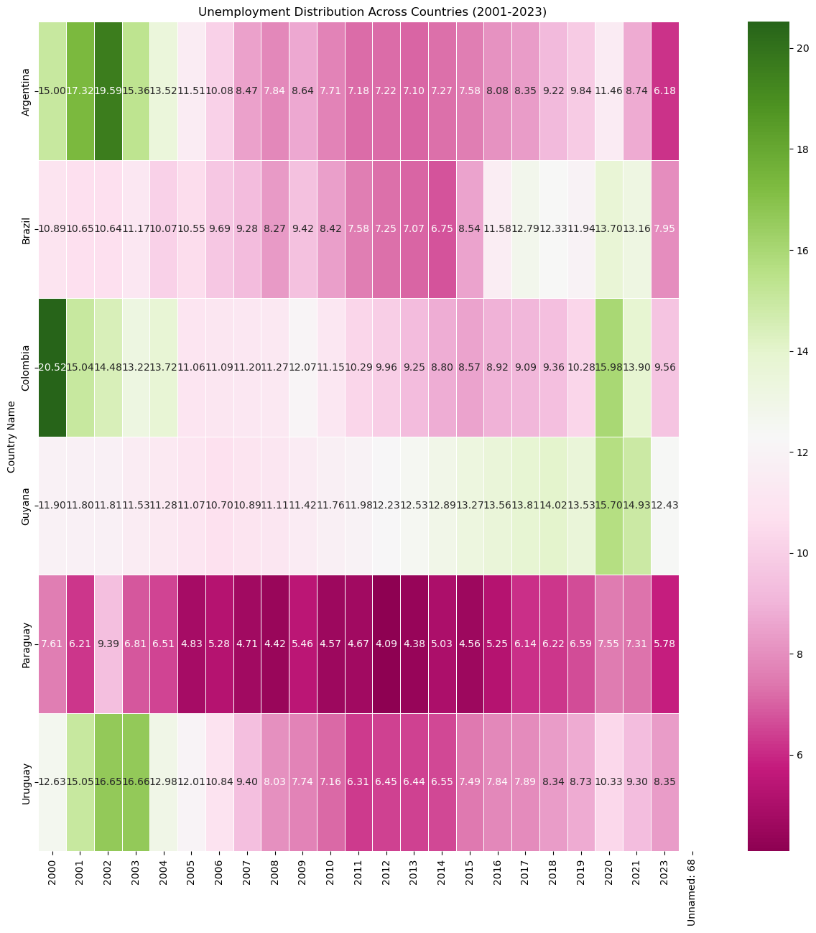
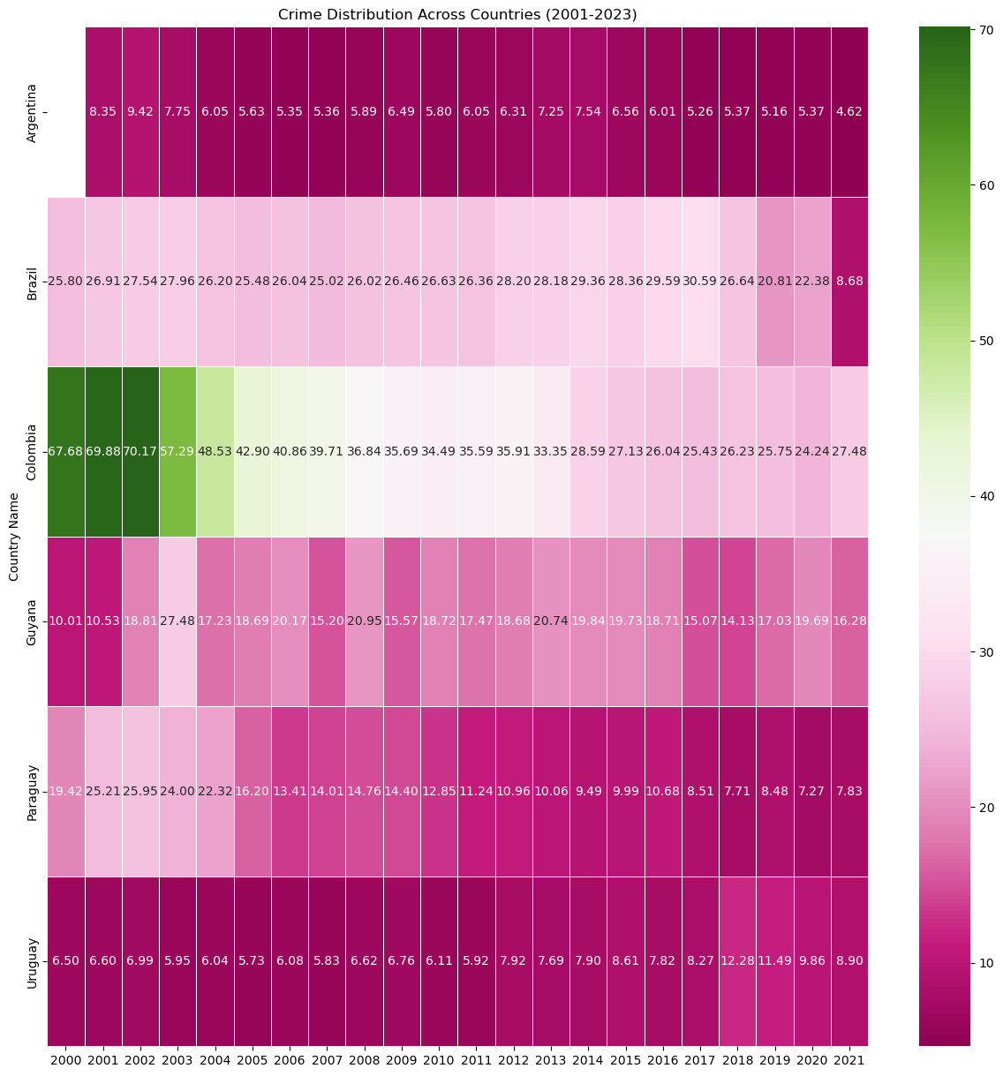
Exploration of datasets
Fig. 3. a) Heatmap for Unemployment data for different countries Fig.3. b) Heatmap for crime data for different countries
Unemployment
Improvement: Argentina sees the most dramatic decline.
Stability: Paraguay maintains consistently low rates.
Fluctuations: Brazil, Guyana, and Uruguay show moderate variability but improve post-2020.
Challenges: Colombia's rates improve but remain relatively high
Crime: Colombia: Significant reduction from initially high rates.
Crime
Argentina & Uruguay: Low and stable crime levels.
Brazil: Moderate rates with some fluctuations.
Paraguay & Guyana: Relatively low and steady crime trends.

Slide 10
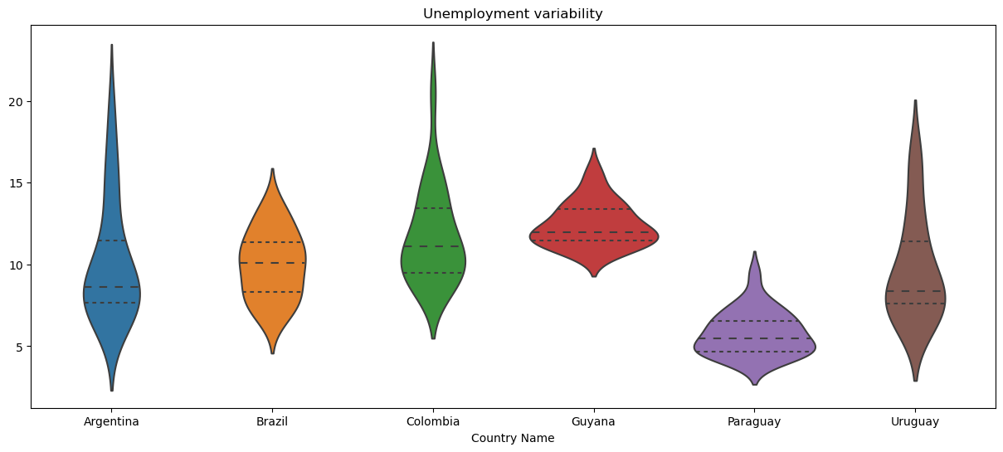
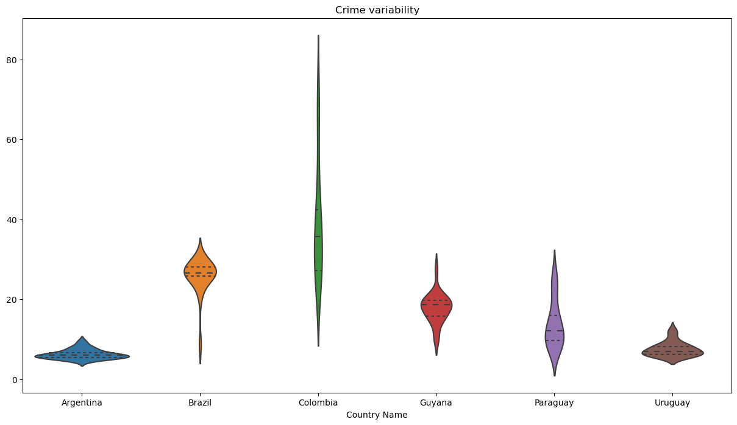
Exploration of datasets
Fig. 4. a) Unemployment Variability Fig. 4. b) Crime rate variability
Unemployment:
High Variability: Argentina shows significant fluctuations.
Stable: Paraguay and Guyana maintain consistent rates.
Moderate Variability: Brazil, Colombia, and Uruguay display balanced fluctuations.
Crime:
High Variability: Colombia shows notable disparities.
Stable: Argentina, Uruguay, and Guyana have steady patterns.
Moderate Trends: Brazil and Paraguay show mild fluctuations

Slide 11

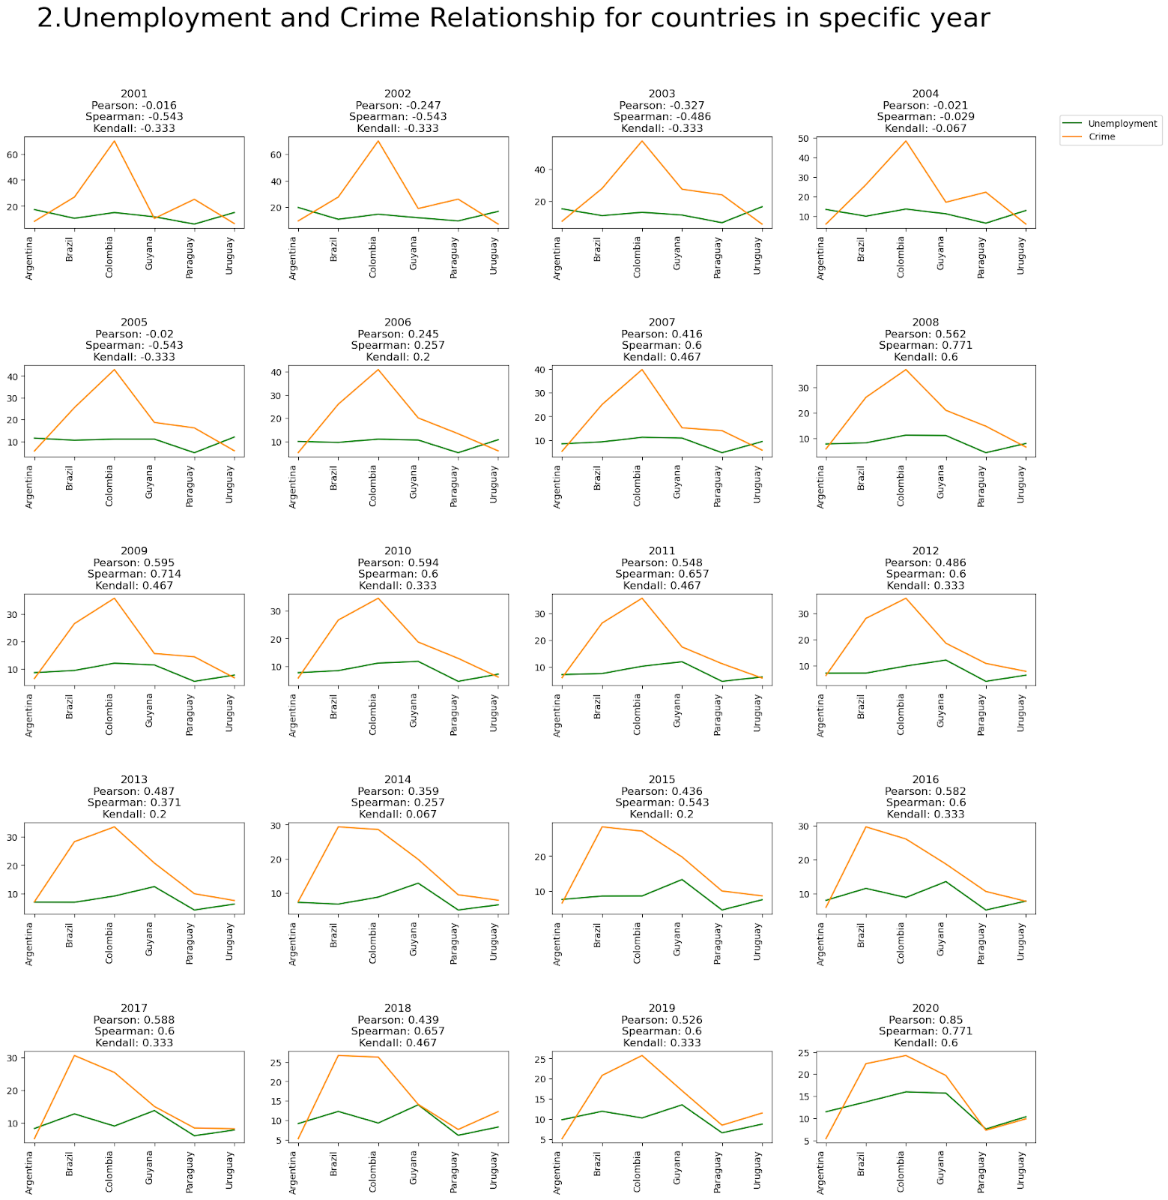
Results
Correlation analysis for all countries over the years
1. Positive Correlation: Argentina and Colombia demonstrate a clear link between declining unemployment and reduced crime rates, with the strongest alignment post-2010.
2. Variable Trends: Brazil and Uruguay show moderate stabilization of crime with lower unemployment, while Guyana and Paraguay exhibit weak or inconsistent correlations, especially during economic disruptions like 2020.
Fig5: Correlation analysis for countries combined over the years

Slide 12



Conclusion
Colombia: Strong link between unemployment and crime.
Brazil & Uruguay: Moderate decline in crime with lower unemployment.
Guyana & Paraguay: Weak correlation between unemployment and crime.
Argentina: Mixed trends influenced by other factors.
- High unemployment doesn't always mean high crime;
both depend on factors like socio-economics, politics, and education.

Slide 13

Limitations
1. Causation Complexity: Correlation ≠ causation; unseen variables complicate the relationship between unemployment and crime.
2. Data Reliability Concerns: Findings rely on accurate data; unaccounted seasonal unemployment, unregistered female unemployment, and passive job seekers pose challenges.
3. Crime Data Validity: Homicide data varies; differing assessments and validation processes result in nuanced interpretations.
4. Granularity and Regional Oversights:Lack of specificity in crime types and regional variations within countries may limit insights.

Slide 14

Future Work
1. Multifactorial Analysis: Examine social policies, education, and economic conditions collectively impacting crime for a nuanced view.
2. Policy Evaluation: Assess diverse policies' influence on unemployment-crime dynamics for effective strategy development.
3. Machine Learning Insights: Use regression trees or neural networks for complex pattern revelation beyond traditional statistics.
4. Global Comparative Studies: Expand analysis beyond MERCOSUR for a broader cross-cultural perspective on unemployment and crime.

Slide 15
THANK YOU
ANY QUESTIONS?

